Slide 1
HPC Ecosystems Project Embracing Online Education for HPC System Administrator Training
SIGHPC Education Global Seminar Series March 2023
Bryan Johnston
Senior Technologist
ACE Lab CHPC, South Africa

Slide 2




bjohnston@ace-lab:[~]$ whoami
HPC Recipient
Principal Technician, UKZN Research & Advanced Computing May 2013 - May 2016
192 core Sun HPC (Ranger chassis)
SysAdmin Training
Student Cluster Competition
TACC & SC’15
HPC Project Lead
Senior HPC Technologist, CHPC
Project Lead: HPC Ecosystems
ACE Lab
June 2016 – present
MS Computer Science (Computing Systems) Georgia Tech, USA OMSCS Programme
“Dear BrYan”​

Slide 3
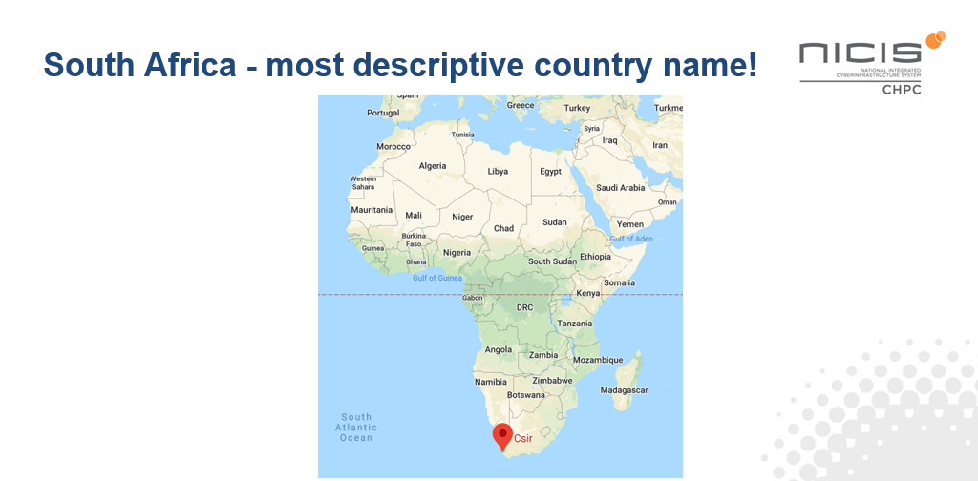
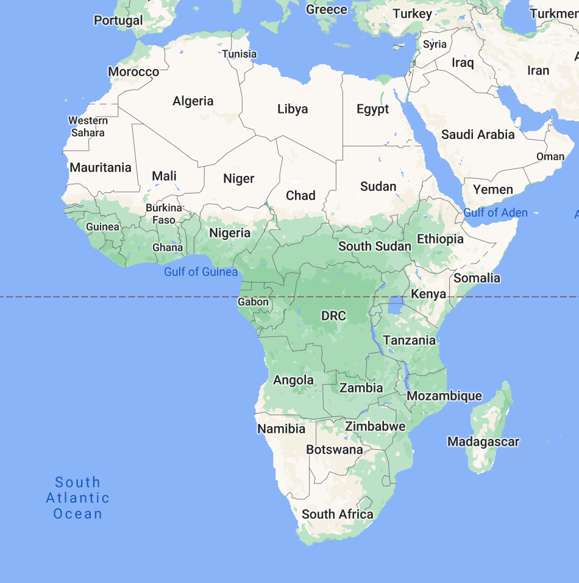
Notes:
I’m calling in from the southern most tip of Africa, which we call South Africa.
Most parts of Africa are generally considered to be resource constrained environments and I will be:
Sharing how we provide online / scalable training for RCE’s in the context of
training for HPC SysAdmins, both for students and professionals

Slide 4
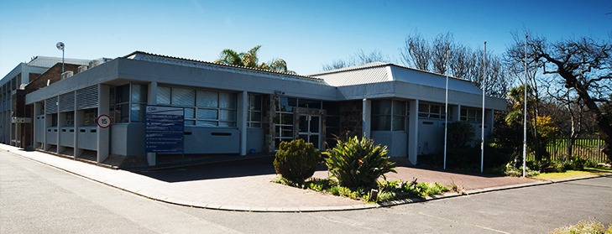

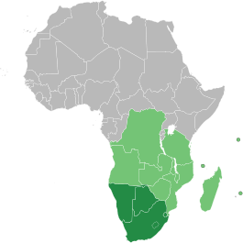
CENTRE FOR HIGH PERFORMANCE COMPUTING
NATIONAL SUPERCOMPUTING FACILITY
1PF system
(just recently) formerly Top500
Largest HPC System in Africa (YMMV)
… FOR RESEARCH COMMUNITY
South African Academic Institutions & Research Facilities
Southern Africa Community partners
SKA partner countries
Notes:
The CHPC is the national SC facility with approx. 30 staff and we service the research community both in SA and also the region;
We support the SKA partner countries and the Southern Africa Community partners (called SADC) so our reach & responsibility encompasses many countries across Africa.

Slide 5
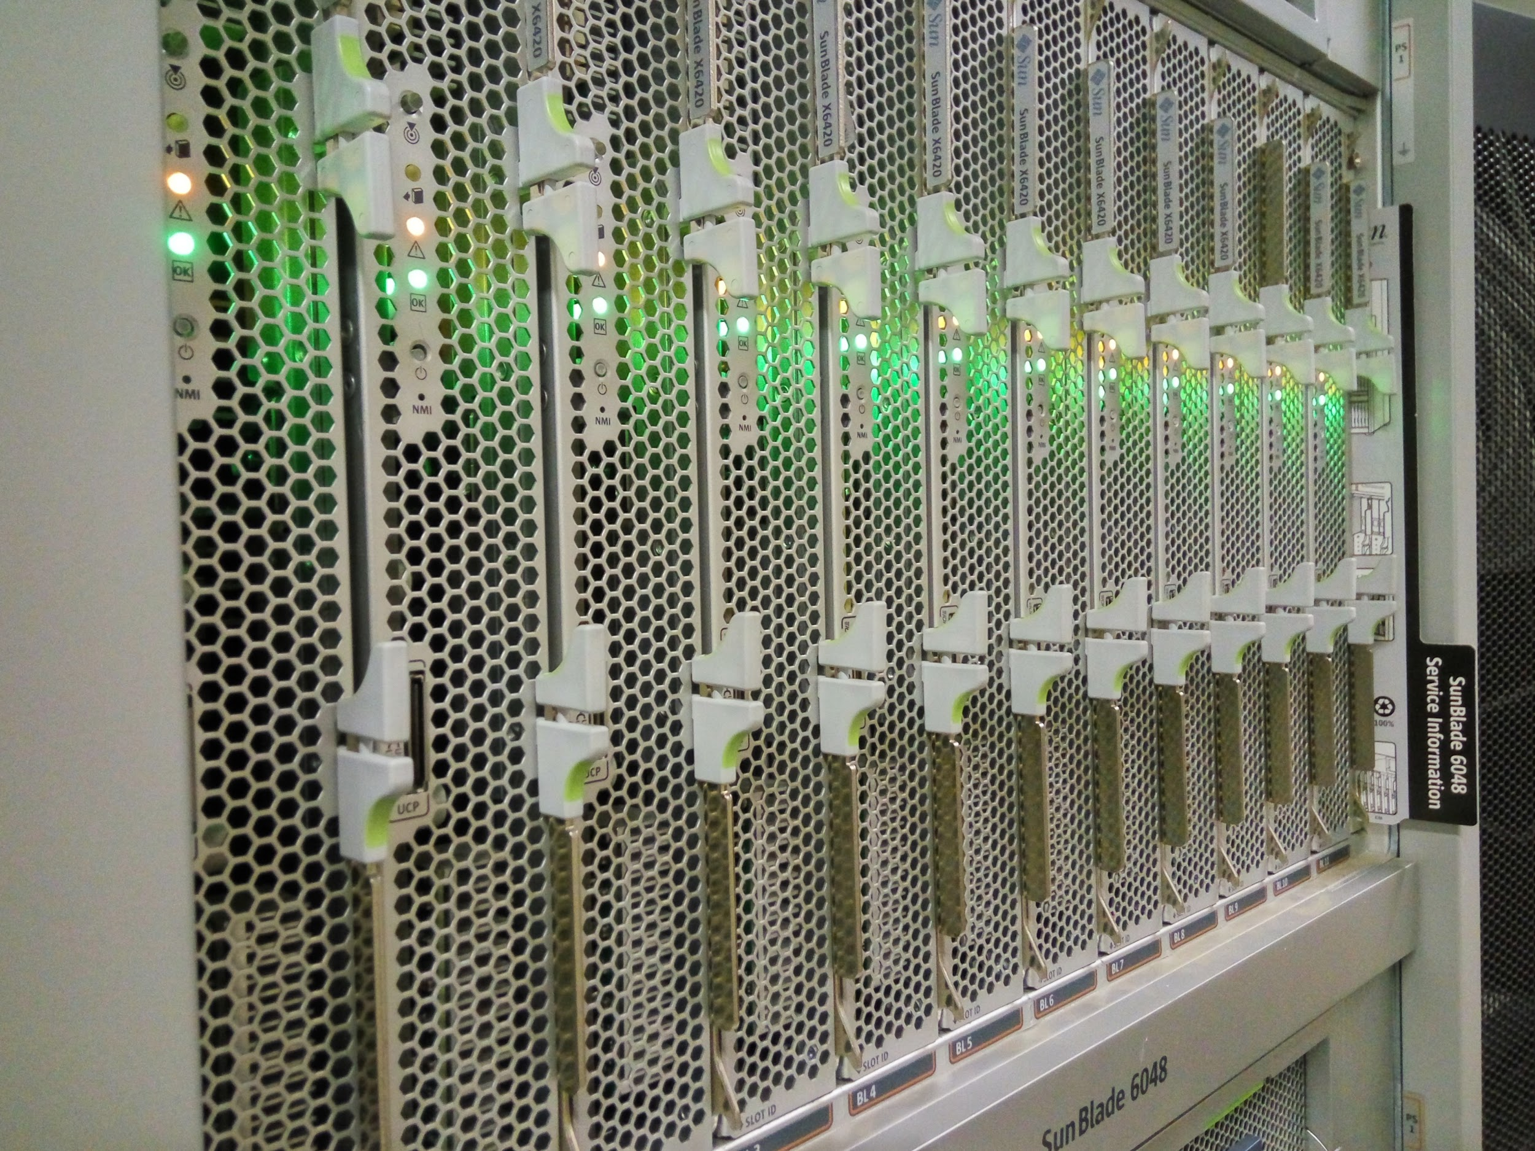

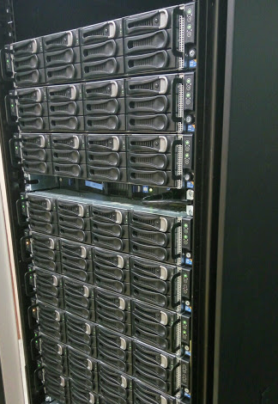
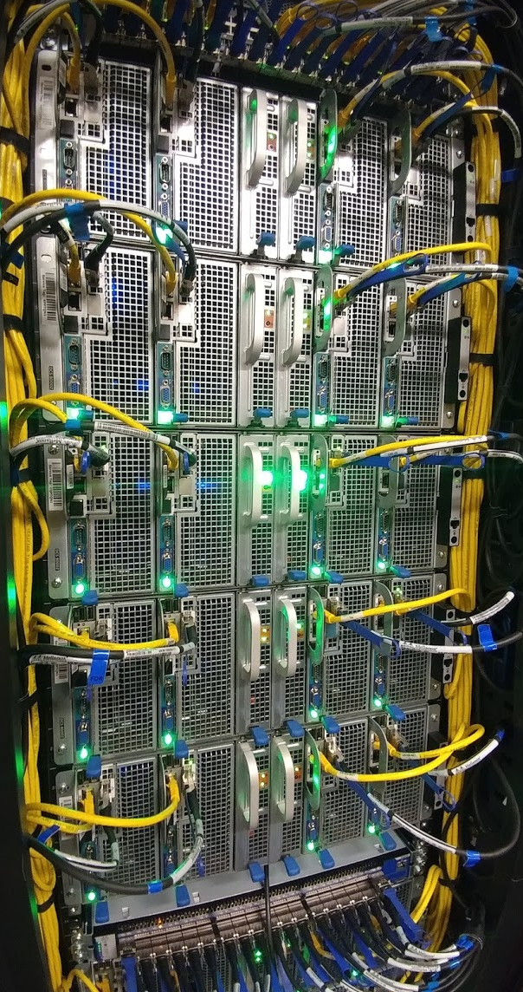
HPC Ecosystems Project
Cambridge
Ranger
C6100
Stampede

Slide 6
HPC Ecosystems Team @ CHPC (18+1)
Advanced Computer Engineering (ACE) Lab
David Macleod (Principal Engineer)
Eugene de Beste (Senior Technologist)
Lara Timm (Engineer)
Mmabatho Hashatsi (Engineer)
Nyameko Lisa (Senior K/A)
Sean February (Senior Technologist)
acelab@chpc.ac.za
Research / Academic Support
Dr. Charles Crosby
Mr. Inus Scheepers
Dr. Mthetho Sovara
Mr. Samuel Mathekga
Dr. Werner Janse van Rensburg
CHPC Operations Support
Funeka Mafani
Lesley Fredericks
Nox Moyake
Dr. Ricardo Harry
CHPC Technical Team
Themba Hlatshwayo
Zama Mtshali
Zintle Sanda

Slide 7
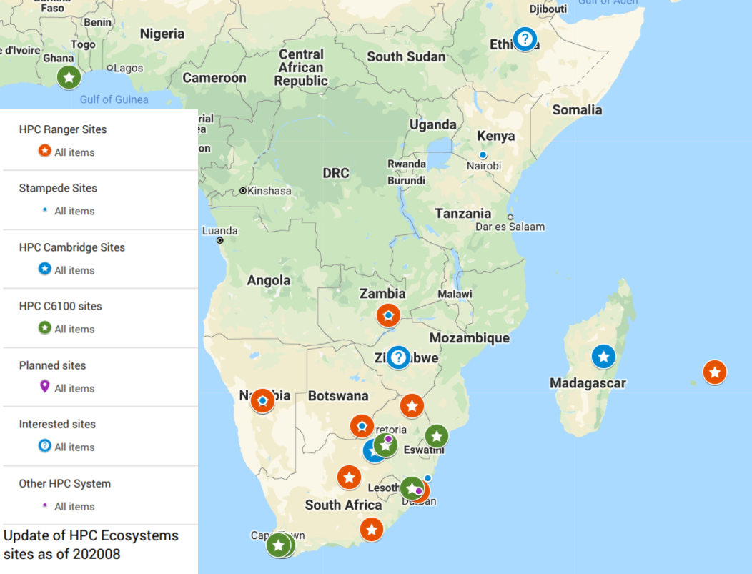
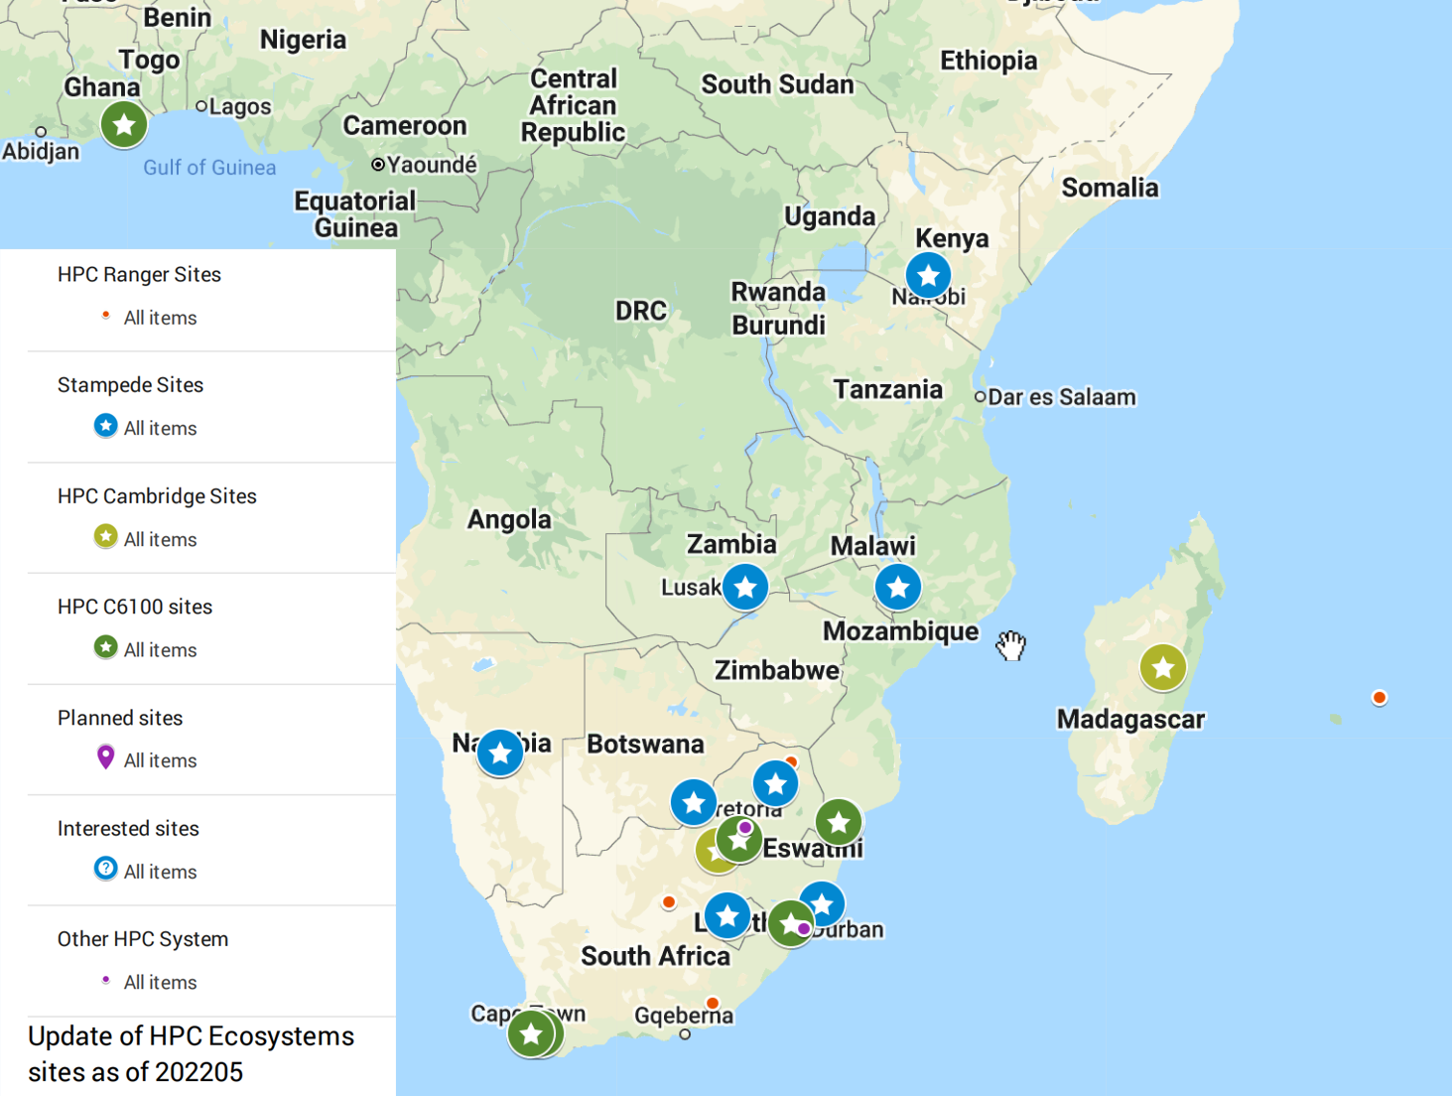
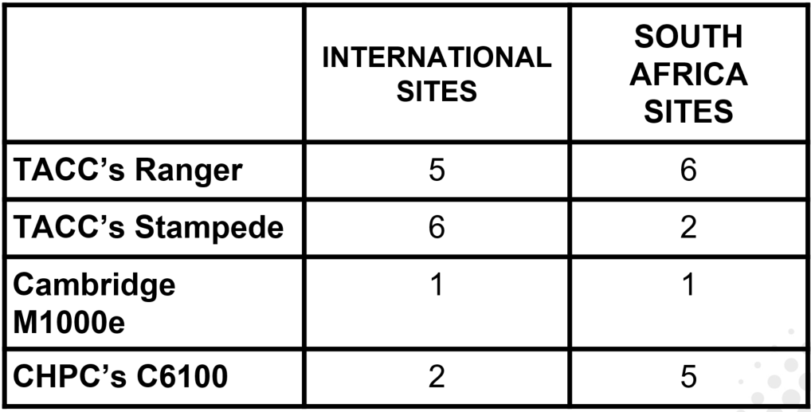
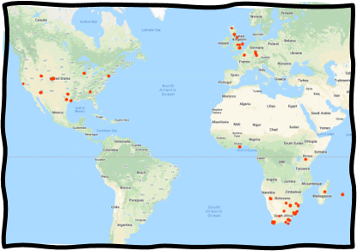
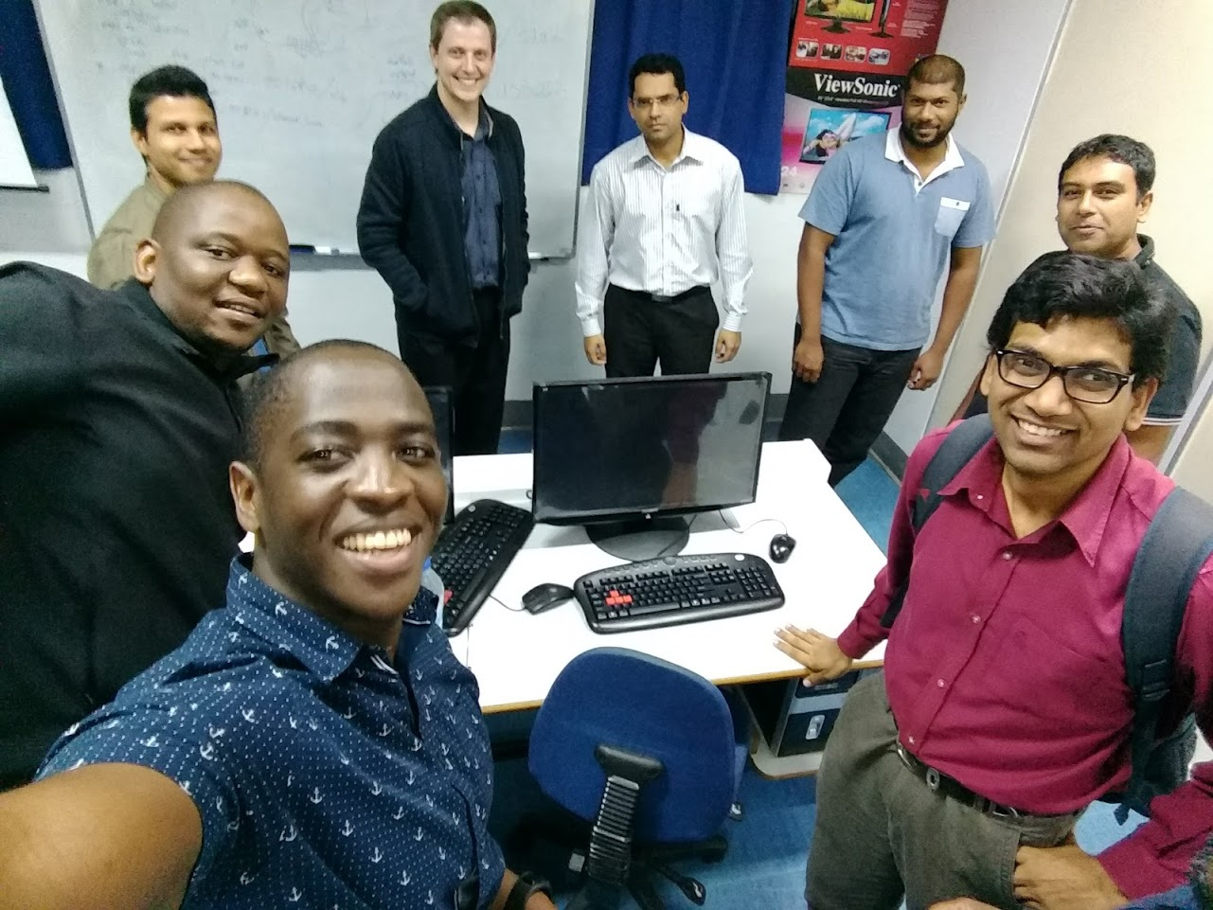
 | GLOBAL (17) | LOCAL (~17)
TACC Ranger | 5 | 6
Cambridge M1000e | 1 | 1
CHPC C6100 | 2 | 5
TACC Stampede | 9 | 3 (+2)
+2
+3

Slide 8
Virtual Community
Platform | Members | Notes
Google Group | 168 | ~16 countries
HPC Educators Africa COP | 13 | A 'spin-off' Google Group community was established at the CHPC National Meeting to represent HPC Educators in HPC Ecosystems partner sites.
HPC Ecosystems Slack | 163 | USA, Europe, Africa community members

Slide 9
How it happens

Slide 10

HPC Ecosystems Project - READINESS
To implement a successful deployment of HPC Ecosystems Resource/s, a site requires:
INFRASTRUCTURE
Power & Cooling
Network Connectivity
# Datacentre
# Sound-proofing
# Ancillary Equipment
# Security
USERS
Research
Teaching
# Computationally-driven Research
# HPC curriculum
# Student Cluster Competition
SUPPORT
Technical
Leadership
# System Administrators
# Scientific Computing & Linux

Slide 11

HPC Ecosystems Project – WHY WAIT?
USERS
Research
Teaching
# Computationally-driven Research
# HPC curriculum
# Student Cluster Competition
BUT WHY WAIT TO BEGIN THE TRAINING???
Research
* Scientific Computing
* Computational Science
* Data Science
Knowledge of HPC use
CAMPUS-WIDE USE
CREATE AWARENESS OF RESOURCE
Teaching
* HPC curriculum
* Student Cluster Competition

Slide 12
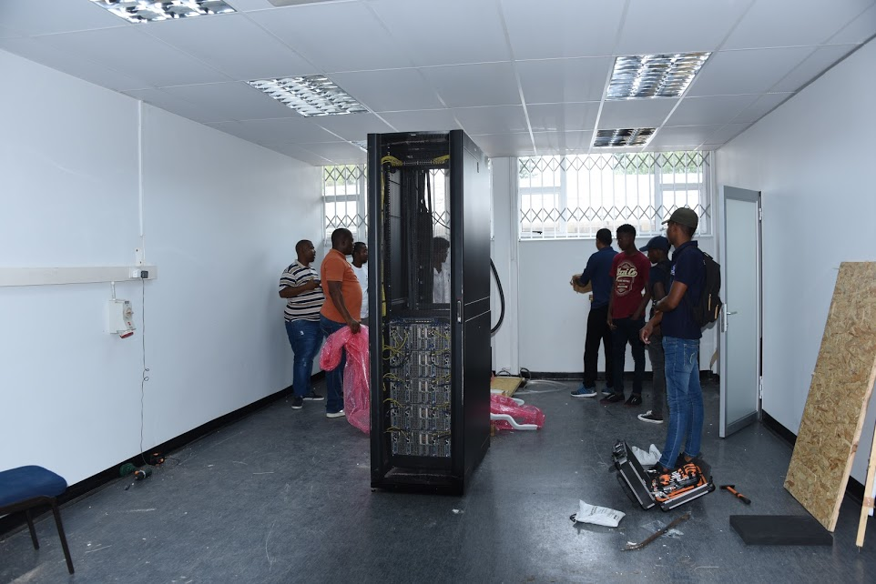
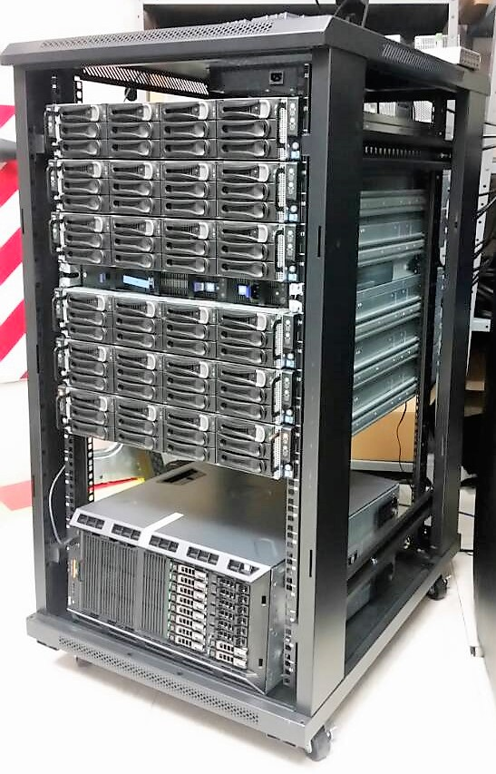
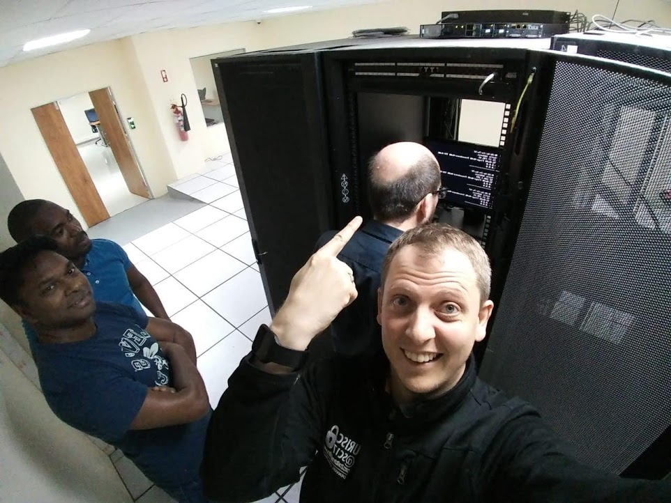
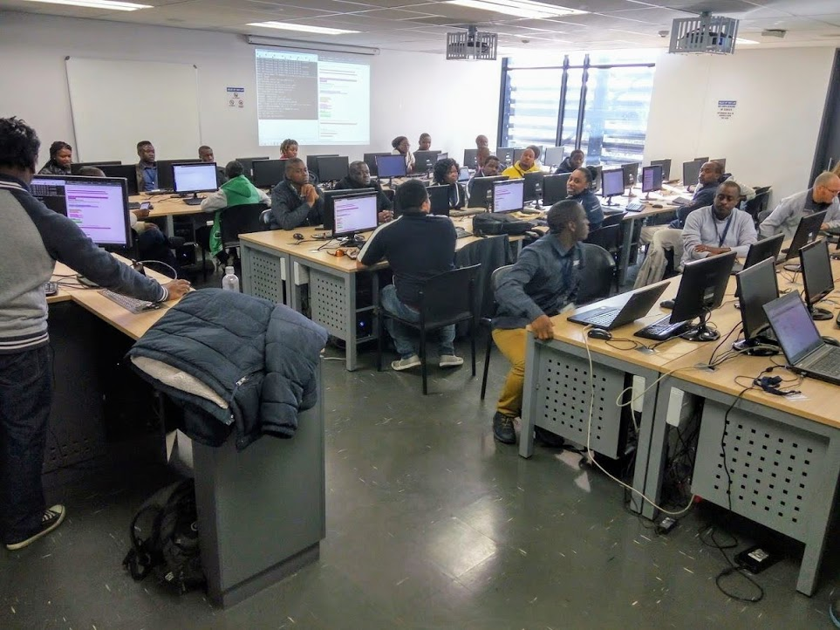

The Traditional HPC Ecosystems Model
Hardware Ready
Site Assessment
Site Deployment
Site Training

Slide 13
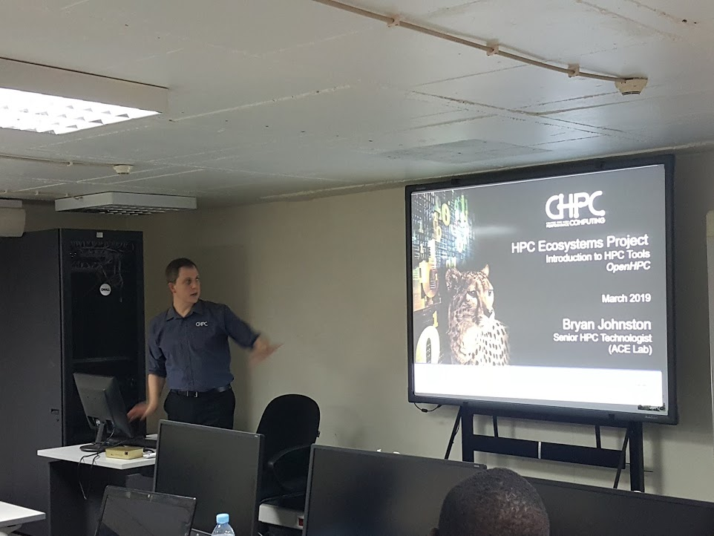
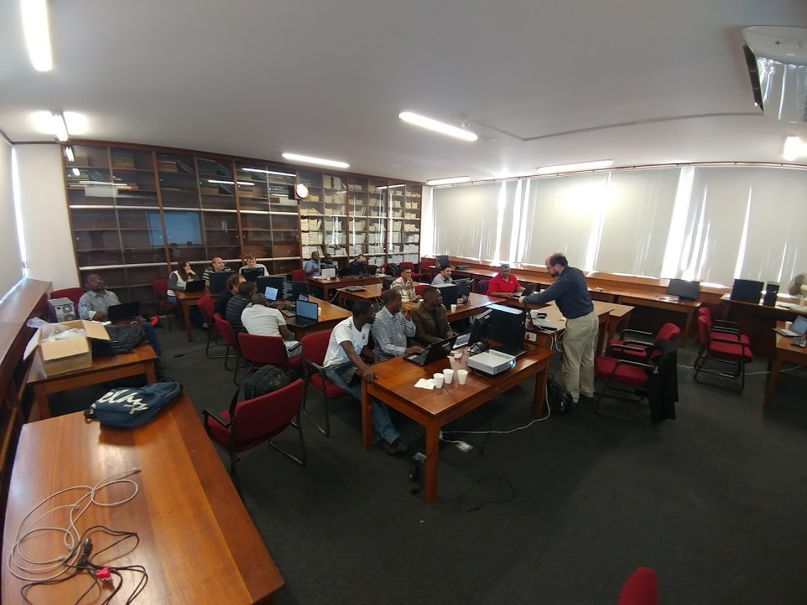
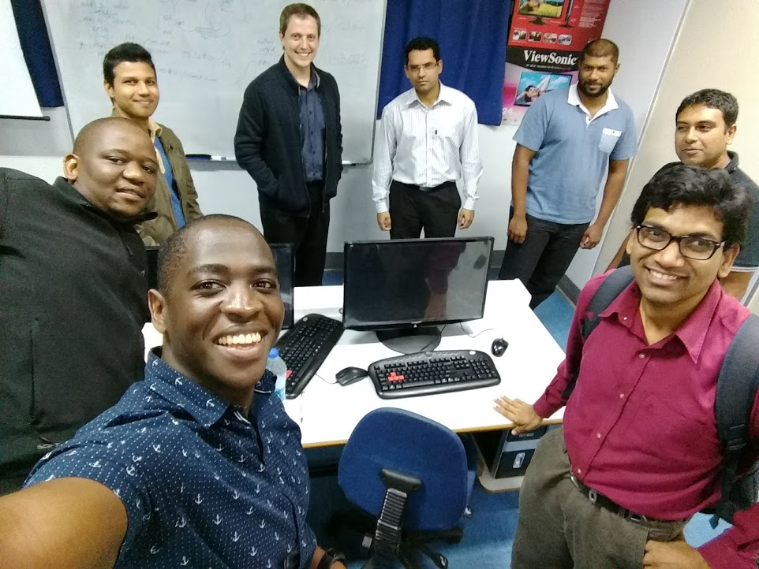
On-site Training (pre-COVID19)

Slide 14


REPEAT train.site() UNTIL 1==2

Slide 15

ONLINE TRAINING
CHPC Winter School
CHPC Student Cluster Competition
HPC Ecosystems Project (for SysAdmins)
OpenHPC Virtual Labs
HPC SysAdmin Workshops
Moved Training Online in 2020
(influenced by …)
Notes:
While COVID obviously accelerated the move to online training,
we had in any case identified the lack of always-available online training resources as being an impediment to our delivery and impact so in that respect we already had a headstart on COVID and were able to fairly quickly launch training workshops during the global lockdown.

Slide 16
TAKING EDUCATION & TRAINING ONLINE
SCALABILITY
Size: can accommodate larger groups
Frequency: can run programs in parallel / quick succession / on-demand etc.
Repeatable!
LOWER OVERHEAD
Cost: not funding participants
Logistics: not hosting a F2F workshop
Workload: long-term, can re-run online course relatively easily.
Notes:
With our move to online delivery, we expected immediate benefits in terms of costs, logistics burden, and workload, while also improving our reach to a larger audience with the ability to train multiple cohorts concurrently

Slide 17
PRINCIPLES LEARNED FROM OMSCS
Accessibility
Data “lite”
Offline availability
Closed-Captions
Replayability
Participants can repeat lessons
Flexibility
Accommodating
User Friendly
Good UX
FAQ / Support Resources
Compatibility
Multiple devices & OS support

Slide 18
ONLINE EDUCATION STRATEGIES
Drop-out / Disengagement
Regular Office Hours
Encourage Collaboration
Incentivise Participation
Confusion / Overwhelming
Community chat
Advice & Tips for online learning
Life Happens
Be understanding!
Make it manageable!
BE HUMAN!!
Notes:
We attempted to address what we believed to be the common pitfalls in online education, particularly in RCE’s.
Essentially we encourage interaction among participants and create an open and welcoming environment that promoted a community of collegiality and collaboration.

Slide 19
Implementation

Slide 20
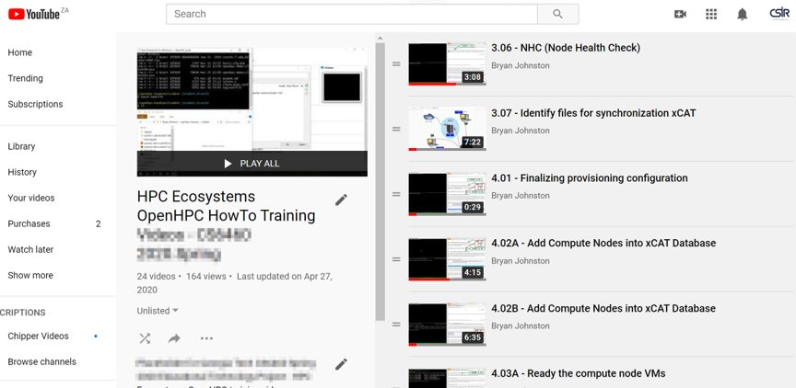
Videos
Accessible
Downloadable
Zero-rated
Captions
Replayable
Compatible
User Friendly
Flexible
On Demand

Slide 21
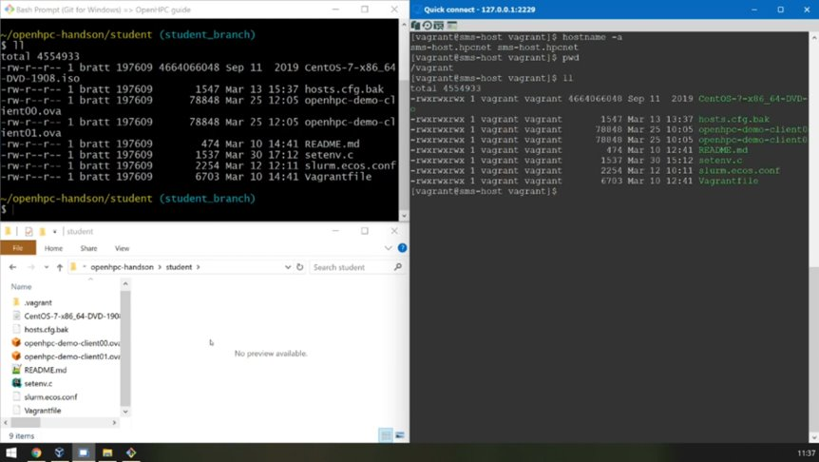
Virtual Labs
Accessible
Off-line
Opensource (GitLab)
Low Resource Requirement
Replayable
Compatible
VirtualBox
User Friendly
YMMV :-)
Flexible
On Demand
Transferable to Production

Slide 22
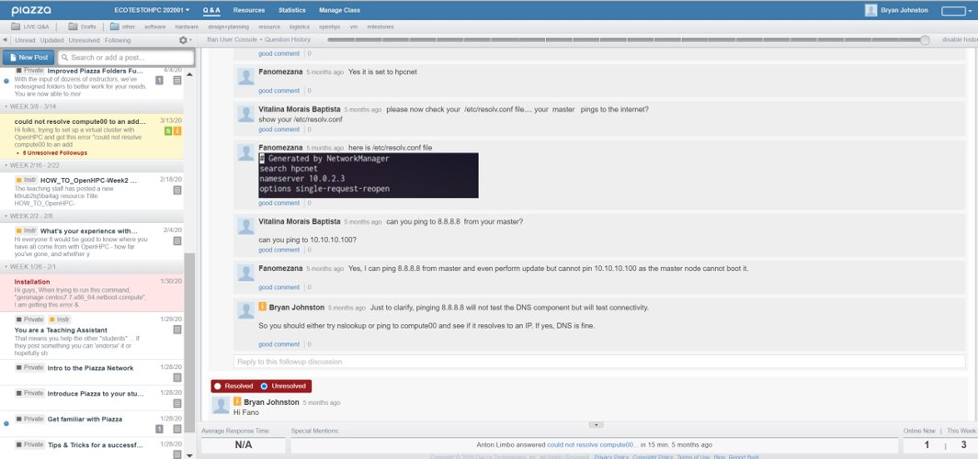
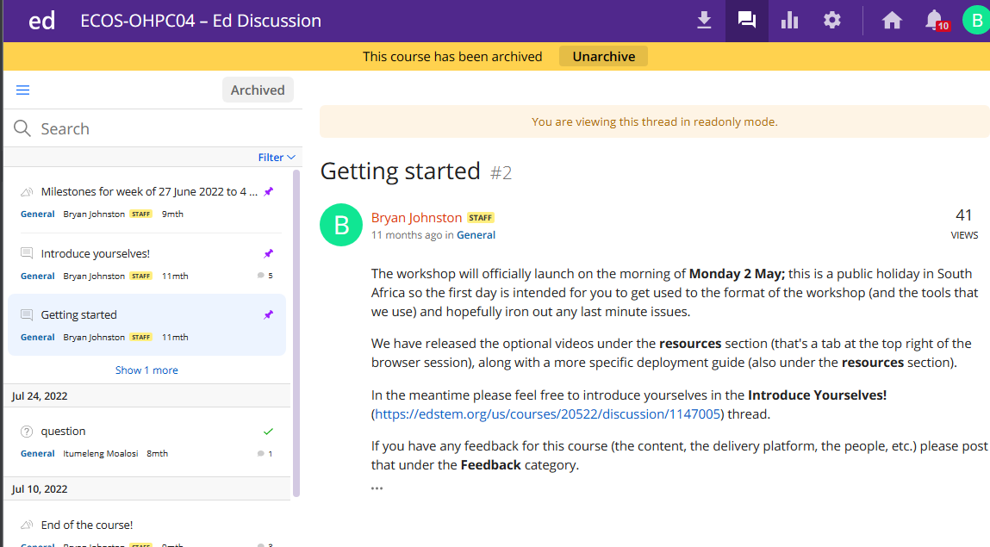
Formal Workshops
Accessible
FREE
Replayable
Quarterly :)
Compatible
Web-clients
User Friendly
YMMV :-)
Flexible
LMS and Slack
1-2 weeks for 15 hours of work

Slide 23
FEEDBACK:
YOU ARE NOT YOUR USER!

Slide 24
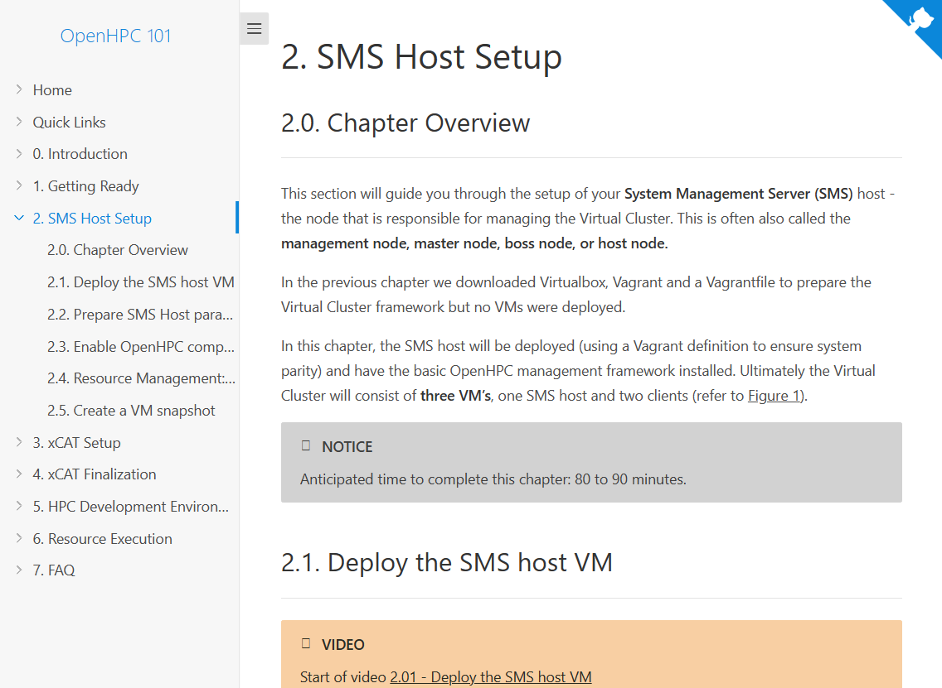
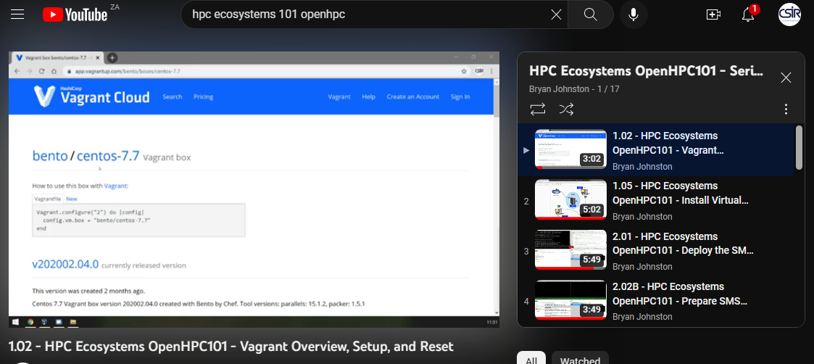
HPC Ecosystems Project – DO IT!
OpenHPC 101 (hpc-ecosystems.gitlab.io)
YouTube: 'hpc ecosystems 101 openhpc'
HPC Ecosystems Slack:
https://tinyurl.com/sighpc-join-ecosystems-slack
HPC Ecosystems Google Group:
http://tinyurl.com/SADC-HPC-Apply
NICIS CHPC Events:
events.chpc.ac.za
Notes:
We deliver training using an asynchronous video delivery platform called YouTube (it’s ubiquitous and has app support for most major devices; and allows participants to download the videos for offline accessibility ). YouTube has native close-caption support in multiple languages.
We deliver topics succinctly in chapters each of around 10 videos, with each video usually being 3 to 6 minutes so participants can digest video content in small bites. We typically pace two chapters per week.

Slide 25

HPC Ecosystems Project -
Acknowledgements
HPC Ecosystems Project Team
HPC Ecosystems Project Community Partners
Texas Advanced Computing Center (TACC)
University of Cambridge
STEM-Trek
EPCC & PRACE
OpenHPC
Notes:
Acknowledgements!

Slide 26

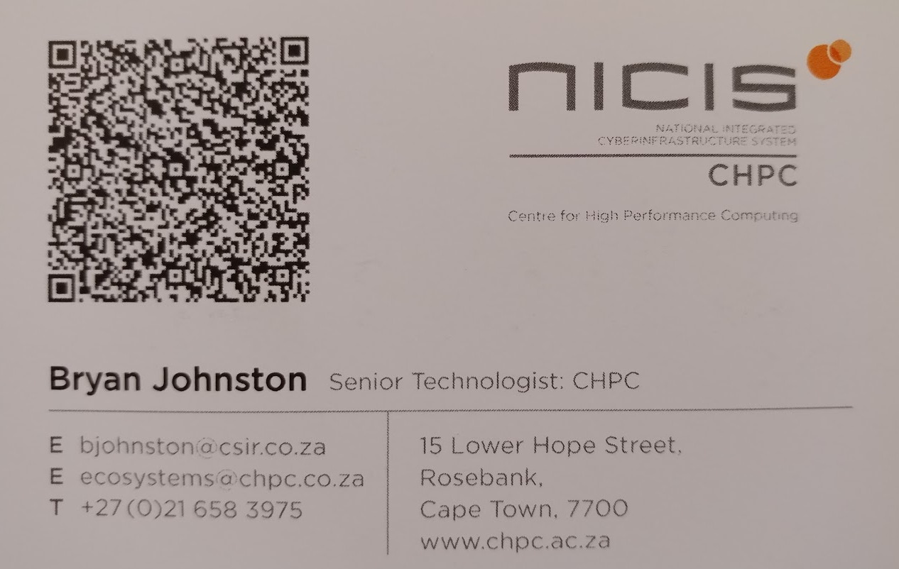

THANK YOU! (and stay safe)
bjohnston@csir.co.za

